Slide 1
The Polyglot Cloud Building 12-factor apps in Java, Scala, Ruby, and Node.js
Neil Shannon - May 15, 2018

Slide 2








About Me
Principal Software Engineer - E-mail Security Polyglot Developer
Java
Scala
Ruby
Node/ES6
Groovy
C/C++
Others...
https://linkedin.com/in/neilshannon
https://github.com/neilshannon
@ntshannon

Slide 3
Agenda
What is a 12-factor app?
How do I build one?
How do I deploy my app?

Slide 4
The 12 Factors
Codebase - use source control
Dependencies - explicitly declare dependencies
Config - Use the environment for configuration
Backing Services - reference external resources by URI in config
Build-Release-Run - separate build/release/run stages. Use versioning.
Processes - Scale out via processes
Port-binding - Bind services to known ports. App should be self-contained.
Concurrency - Scale out, not up. Maintain statelessness.
Disposability - App should shut down gracefully, start up quickly
Dev/Prod Parity - Keep dev and prod environments identical if possible
Logs - Treat logs as a stream of events. Don’t archive, rollover, log to filesystem
Admin Processes - Keep one-off processes out of main app code

Slide 5
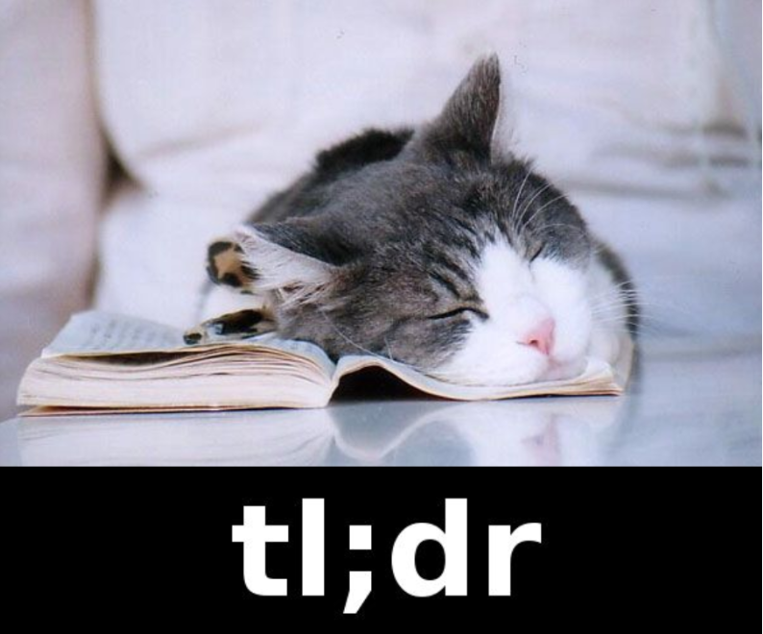
A 12-factor app is designed to run and scale in the cloud.

Slide 6

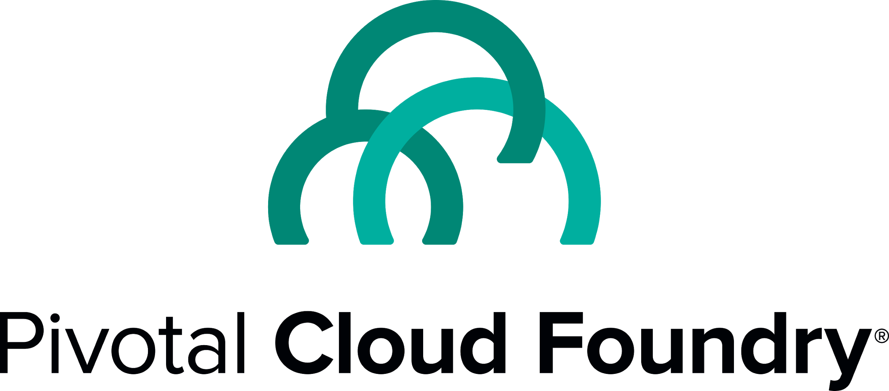
Deployment Environment

Slide 7

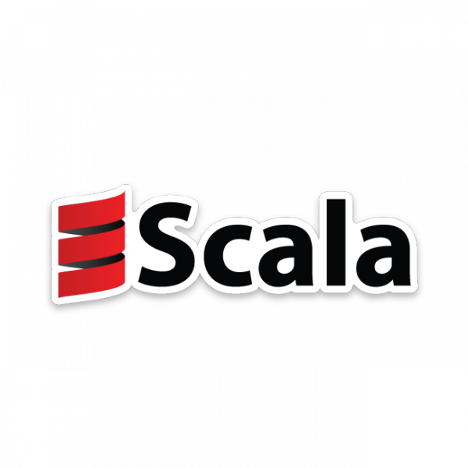

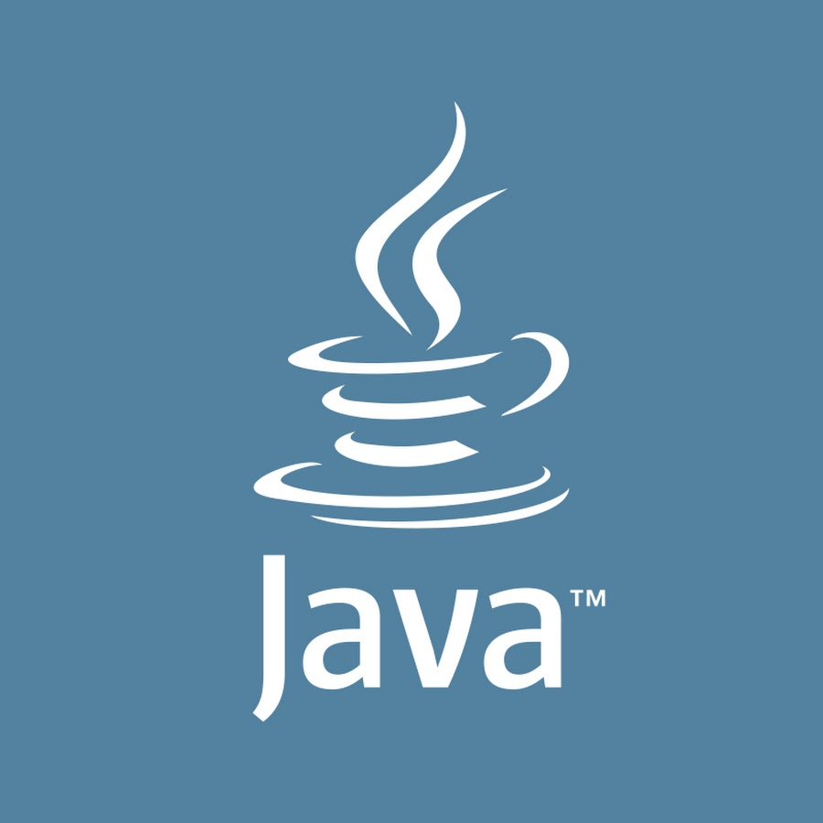
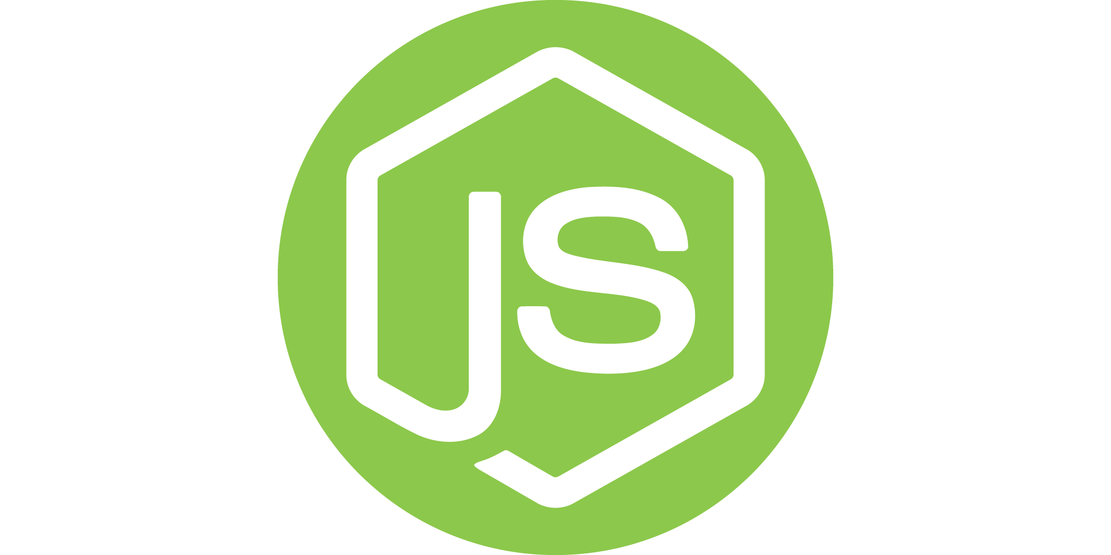
Deployment Environment
dev
uat

Slide 8

Similarities and Differences
Same
Application Code
Access to Config
Build Model
Deployment Model
Resources
Different
Config Values
Endpoint URIs
Scaling

Slide 9
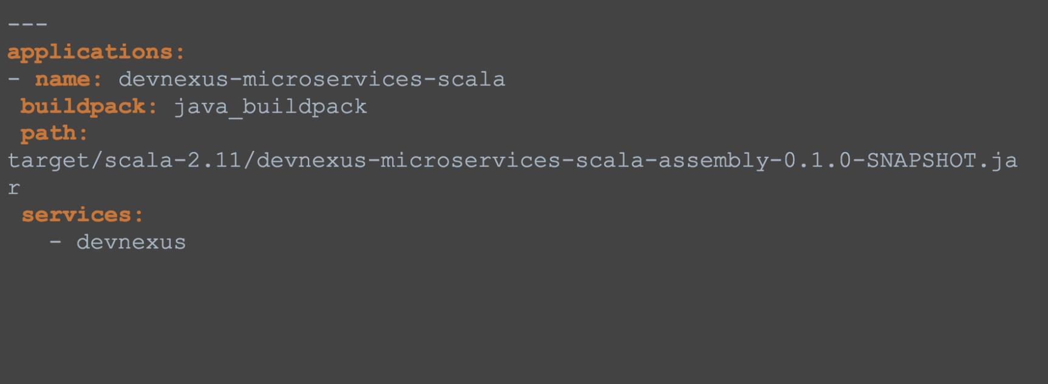
Deployment: the Cloud Manifest
manifest.yml

Slide 10
To the code!

Slide 11
Resources
The 12 Factors - https://12factor.net/
Cloud Foundry - https://www.cloudfoundry.org/
Pivotal Web Services - https://run.pivotal.io/
Source Code - https://github.com/neilshannon/devnexus-microservices

